Slide 1
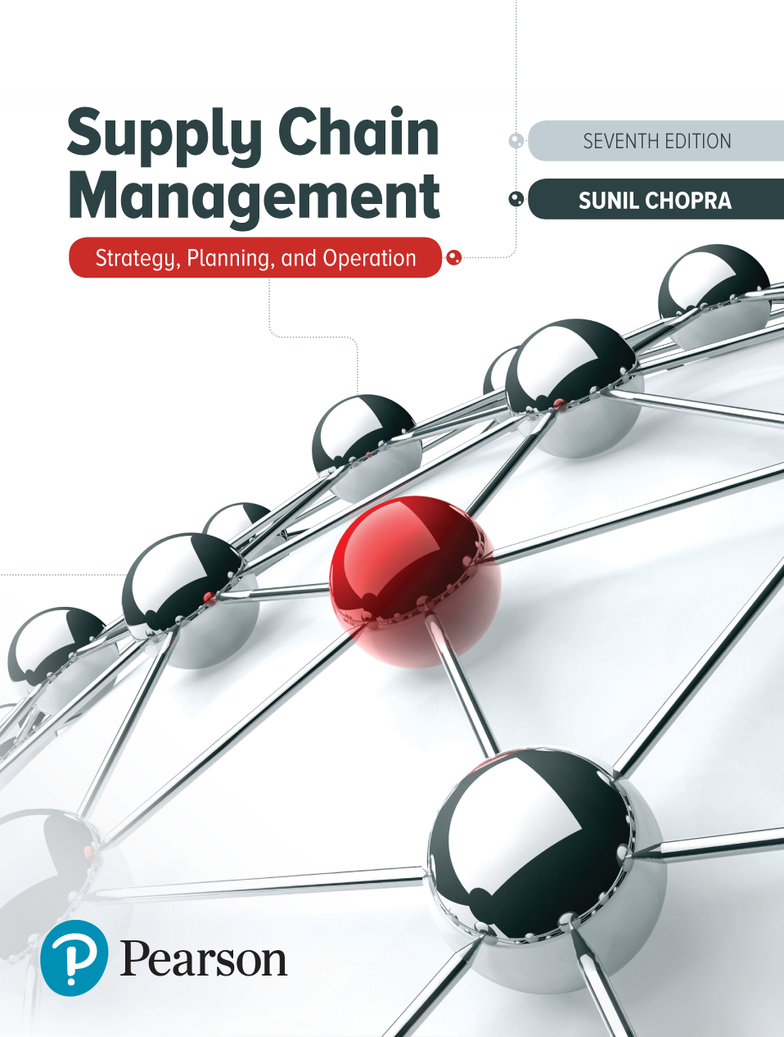
Supply Chain Management: Strategy, Planning, and Operation
Seventh Edition
Chapter 10
Coordination in a Supply Chain
Copyright © 2019, 2016, 2013 Pearson Education, Inc. All Rights Reserved
Notes:
If this PowerPoint presentation contains mathematical equations, you may need to check that your computer has the following installed:
1) MathType Plugin
2) Math Player (free versions available)
3) NVDA Reader (free versions available)

Slide 2
Learning Objectives
10.1 Describe supply chain coordination and the bullwhip effect, and their impact on supply chain performance.
10.2 Identify obstacles to coordination in a supply chain.
10.3 Discuss managerial levers that help achieve coordination in a supply chain.
10.4 Understand some practical approaches to improve coordination in a supply chain.

Slide 3
Lack of Supply Chain Coordination and Its Impact on Performance
Supply chain coordination – all stages of the chain take actions that are aligned and increase total supply chain surplus
Requires that each stage share information and take into account the effects of its actions on the other stages
Lack of coordination results when:
Objectives of different stages conflict
Information moving between stages is delayed or distorted

Slide 4
Bullwhip Effect (1 of 2)
Fluctuations in orders increase as they move up the supply chain from retailers to wholesalers to manufacturers to suppliers
Distorts demand information within the supply chain
Results from a loss of supply chain coordination

Slide 5
Bullwhip Effect (2 of 2)
Figure 10-1 Demand Fluctuation at Different Stages of a Supply Chain

Slide 6
The Effect on Performance (1 of 2)
Lack of coordination increases variability and hurts supply chain surplus
Impact on costs
Manufacturing cost
Inventory cost
Replenishment lead time
Transportation cost
Labor cost for shipping and receiving
Level of product availability
Relationships across the supply chain

Slide 7
The Effect on Performance (2 of 2)
Table 10-1 Impact of the Lack of Coordination on Supply Chain Performance
Performance Measure | Impact of the Lack of Coordination
Manufacturing cost | Increases
Inventory cost | Increases
Replenishment lead time | Increases
Transportation cost | Increases
Shipping and receiving cost | Increases
Level of product availability | Decreases
Profitability | Decreases

Slide 8
Summary of Learning Objective 1
Supply chain coordination requires all stages to take actions that maximize total supply chain profits. A lack of coordination results if different stages focus on optimizing their local objectives or if information is distorted as it moves across the supply chain. The phenomenon that fluctuation in orders increases as one moves up the supply chain from retailers to wholesalers to manufacturers to suppliers is referred to as the bullwhip effect. This effect results in an increase in all costs in the supply chain and a decrease in customer service levels. The bullwhip effect moves all parties in the supply chain away from the efficient frontier and results in a decrease of both customer satisfaction and profitability within the supply chain.

Slide 9
Obstacles to Coordination in a Supply Chain
Incentive Obstacles
Information Processing Obstacles
Operational Obstacles
Pricing Obstacles
Behavioral Obstacles

Slide 10
Incentive Obstacles
Occur when incentives offered to different stages or participants in a supply chain lead to actions that increase variability and reduce total supply chain profits
Local optimization within functions or stages of a supply chain
Sales force incentives

Slide 11
Information Processing Obstacles
When demand information is distorted as it moves between different stages of the supply chain, leading to increased variability in orders within the supply chain
Forecasting based on orders and not customer demand
Lack of information sharing

Slide 12
Operational Obstacles (1 of 2)
Occur when placing and filling orders lead to an increase in variability
Ordering in large lots
Large replenishment lead times
Rationing and shortage gaming

Slide 13
Operational Obstacles (2 of 2)
Figure 10-2 Demand and Order Stream with Orders Every Five Weeks

Slide 14
Pricing Obstacles (1 of 2)
When pricing policies for a product lead to an increase in variability of orders placed
Lot-size based quantity decisions
Price fluctuations

Slide 15
Pricing Obstacles (2 of 2)
Figure 10-3 Retailer Sales and Manufacturer Shipments of Soup

Slide 16
Behavioral Obstacles (1 of 2)
Problems in learning within organizations that contribute to information distortion
Each stage of the supply chain views its actions locally and is unable to see the impact of its actions on other stages
Different stages of the supply chain react to the current local situation rather than trying to identify the root causes
Different stages of the supply chain blame one another for the fluctuations

Slide 17
Behavioral Obstacles (2 of 2)
No stage of the supply chain learns from its actions over time
A lack of trust among supply chain partners causes them to be opportunistic at the expense of overall supply chain performance

Slide 18
Summary of Learning Objective 2
A key obstacle to coordination in the supply chain is misaligned incentives that result in different stages optimizing local objectives instead of total supply chain profits. Other obstacles include lack of information sharing, operational inefficiencies leading to large replenishment lead times and large lots, sales force incentives that encourage forward buying, rationing schemes that encourage inflation of orders, promotions that encourage forward buying, and a lack of trust that makes any effort toward coordination difficult.

Slide 19
Managerial Levers to Achieve Coordination
Aligning goals and incentives
Improving information accuracy
Improving operational performance
Designing pricing strategies to stabilize orders
Building strategic partnerships and trust

Slide 20
Aligning Goals and Incentives
Align goals and incentives so that every participant in supply chain activities works to maximize total supply chain profits
Align goals across the supply chain
Align incentives across functions
Pricing for coordination
Alter sales force incentives from sell-in (to the retailer) to sell-through (by the retailer)

Slide 21
Improving Information Visibility and Accuracy
Sharing customer demand data
Implementing collaborative forecasting and planning
Designing single-stage control of replenishment
Continuous replenishment programs (C R P)
Vendor managed inventory (V M I)

Slide 22
Improving Operations to Synchronize Supply and Demand
Reducing replenishment lead time
Reducing lot sizes
Rationing based on past sales and sharing information to limit gaming

Slide 23
Designing Pricing Strategies to Stabilize Orders
Encouraging retailers to order in smaller lots and reduce forward buying
Moving from lot size-based to volume-based quantity discounts
Stabilizing pricing

Slide 24
Building Strategic Partnerships and Trust
Easier to use levers to achieve coordination if trust and strategic partnerships are built
Sharing accurate information
Lower transaction costs between stages
All parties must believe that the benefits of improved coordination are being shared equally

Slide 25
Improving Coordination in Practice
Get top management commitment for coordination
Devote resources to coordination
Focus on communication with other stages

Slide 26
Summary of Learning Objective 3
Managers can improve coordination in the supply chain by aligning goals and incentives across different functions and stages of the supply chain. Other actions that managers can take to improve coordination include sharing of sales information and collaborative forecasting and planning, implementation of single-point control of replenishment, improving operations to reduce lead times and lot sizes, E D L P and other pricing strategies that limit forward buying, and the building of trust and strategic partnerships within the supply chain. Top management commitment, the devotion of resources to coordination, and a focus on communication across the supply chain are important requirements for coordination to improve in practice.

Slide 27
Some Practical Approaches to Improve Supply Chain Coordination (1 of 2)
Continuous replenishment and vendor-managed inventories
A single point of replenishment
C R P – wholesaler or manufacturer replenishes based on P O S data
V M I – manufacturer or supplier is responsible for all decisions regarding inventory
Substitutes

Slide 28
Some Practical Approaches to Improve Supply Chain Coordination (2 of 2)
Collaborative planning, forecasting, and replenishment (C P F R)
Sellers and buyers in a supply chain may collaborate along any or all of the following
Strategy and planning
Demand and supply management
Execution
Analysis

Slide 29
Common C P F R Scenarios
Table 10-2 Four Common C P F R Scenarios
C P F R Scenario | Where Applied in Supply Chain | Industries Where Applied
Retail event collaboration | Highly promoted channels or categories | All industries other than those that practice E D L P
D C replenishment collaboration | Retail D C or distributor D C | Drugstores, hardware, grocery
Store replenishment collaboration | Direct store delivery or retail D C-to-store delivery | Mass merchants, club stores
Collaborative assortment planning | Apparel and seasonal goods | Department stores, specialty retail

Slide 30
Collaborative Planning, Forecasting, and Replenishment (C P F R) (1 of 2)
Retail event collaboration
D C replenishment collaboration
Store replenishment collaboration
Collaborative assortment planning
Organizational and technology requirements for successful C P F R
Risks and hurdles for a C P F R implementation

Slide 31
Collaborative Planning, Forecasting, and Replenishment (C P F R) (2 of 2)
Figure 10-4 Collaborative Organizational Structure

Slide 32
Summary of Learning Objective 4
V M I and C P F R are two practical approaches to improve coordination in the supply chain. Under V M I, the supplier is responsible for managing product inventories at the retailer while ensuring an agreed upon level of service. Under C P F R, supply chain members manage forecasting, planning, and replenishment in a collaborative manner. Partners may set C P F R relationships to collaborate on store events, D C replenishment, store replenishment, or assortment planning. D C replenishment collaboration is often the easiest to implement because it requires aggregate-level data. Store replenishment collaboration requires a higher level of investment in technology and data sharing to be successful.

Slide 33

Copyright

